Slide 1
Computing at Annie Lennard
Parent Workshop
Mr Smith
26.04.2023

Slide 2
Why we teach computing
Computers are at the centre of our lives.
How many devices in your house now include computers?
Computer science is a critically important, influential, and growing, part of the UK (and world) economy. People with relevant skills are highly sought after, and are in short supply.
In response to these challenges, the computing curriculum changed in 2014 from a curriculum focussed on ‘ICT skills’ to a more rigorous curriculum focussed on computer science / coding.

Slide 3
But more importantly…
Computing encourages problem-solving, creative thinking, teamwork, resilience …
… and computing is fun!

Slide 4
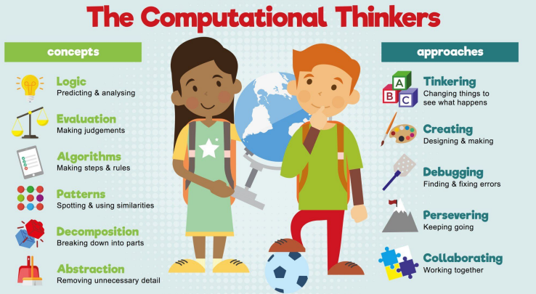

Slide 5
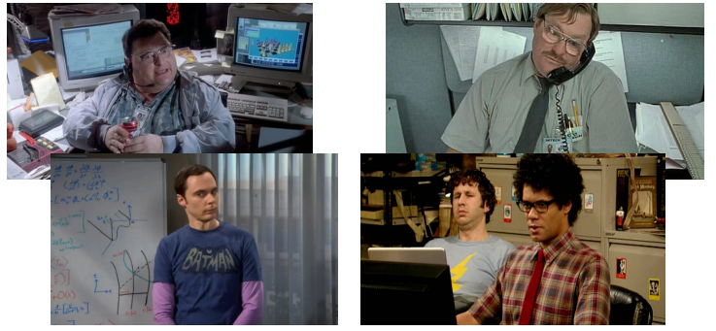

Slide 6
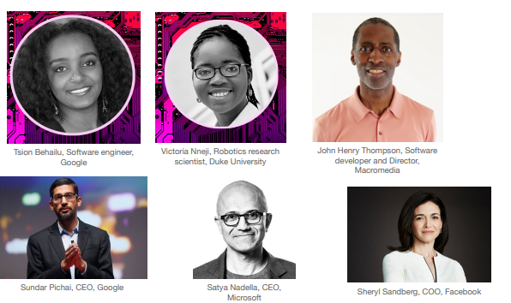

Slide 7
National Curriculum
Computing
Digital literacy
Information technology
Computer Science
Networking (KS2 Only)

Slide 8
The national curriculum
The National Curriculum targets for both KS1 and KS2 can be separated into three separate strands.
Information technology explores basic computing skills, such as word processing skills, and allow for the children to develop the skills they need to be able to understand how technology works and how they can use it for different purposes.
Computer science and digital literacy is where children develop the skill of using a computer to help solve problems. This strand also covers coding in which the children will develop skills of how to write algorithms and how they can debug any errors that arise. I
In KS2, this strand also includes developing an understanding of networks and how they work, such as how the internet provides multiple opportunities for communication and collaboration. Digital literacy covers online safety, ensuring children know the possible risks and are using technology safely.
In EYFS, there are no explicit computing targets, however computing can link to other aspects of the EYFS curriculum.

Slide 9
How this is taught in school
All year groups in KS1 and KS2 have a timetabled hour each week to teach the skills and knowledge required,
However, this doesn’t have to always be the case. Most of the statements within the information technology stand can be covered through other subjects within the curriculum.
However, it needs to be made clear that the computing lesson still has a place within the curriculum as computer science will need a more explicit teaching approach. Also, apps and or tools within various programmes will benefit from the explicit teaching before it is used across other areas of the curriculum.
Computing in EYFS takes place throughout the day when opportunities become available and through planned teacher activities.

Slide 10
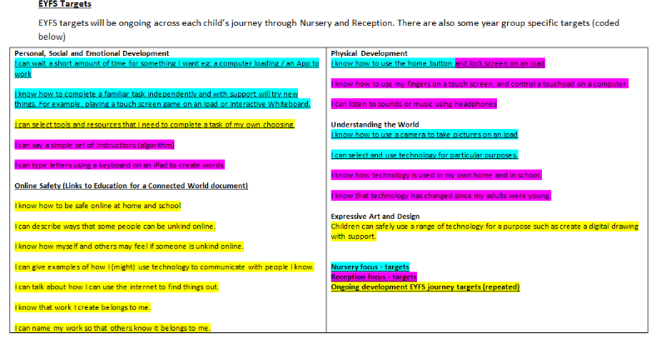
EYFS

Slide 11
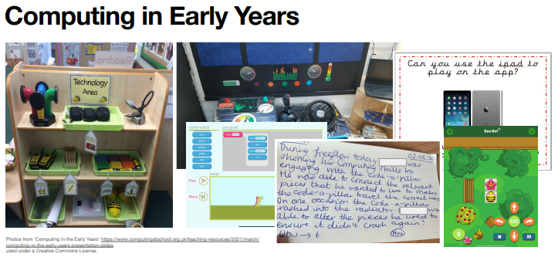
Computing in early years

Slide 12
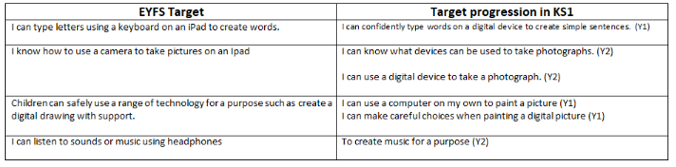
EYFS to KS1

Slide 13
Overview of Topics
 | Autumn 1 | Autumn 2 | Spring 1 | Spring 2 | Summer 1 | Summer 2
Year 1 | Word Processing/Typing | Data Handling -sorting and comparing | Media (Image) – Digital Painting | Computer Science – Computational thinking/ Coding and programming |  | Time to consolidate skills
Year 2 | Word Processing/Typing | Data Handling - Pictograms | Media (Image) - Photography | Computer Science – Computational thinking/ Coding and programming |  | Media (Sound and Video) – Creating Music
Year 3 | Word Processing/Typing | Data Handling – Branching Database | Media (Sound and Video) - Animation | Computer Science – Computational thinking/ Coding and programming |  | Networks
Year 4 | Word Processing/Typing | Media (Image) – Editing and altering images | Media (Sound and Video) -Audio | Computer Science – Computational thinking/ Coding and programming |  | Networks
Year 5 | Word Processing/Typing | Data Handling - databases | Media (Sound and Video) – Video documentaries | Computer Science – Computational thinking/ Coding and programming |  | Networks
Year 6 | Word Processing/Typing | Data Handling - Spreadsheets | Media (Image) – 3D modelling | Computer Science – Computational thinking/ Coding and programming |  | Networks

Slide 14








Programmes used across KS1 and KS2
And many many more…

Slide 15
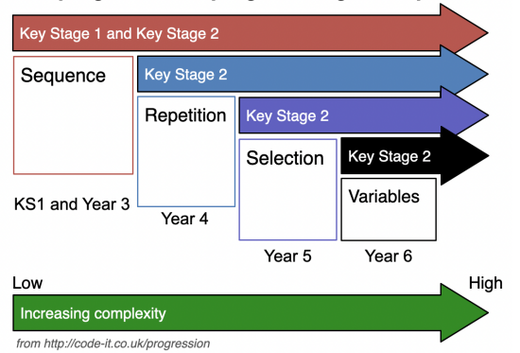
Progression of coding skills
A variable is a way of storing information in a computer program. Think of a variable like a container and the name of the variable as the label on the container which shows us what is inside. Variables are used in coding and programming to help coders understand, remember, and use the information in the program.
Repetition is often also referred to as loops. In computer programming, repetition is the process of looping or repeating sections of a computer program.
There are different types of loop. The most basic is where a set of instructions is repeated a set number of times. Another type of loop repeats continuously until a certain condition is met.
Selection is a decision within a computing program when the program decides to move on based on the results of events or criteria being met.
Sequencing is the order of steps that a computer must take to complete a task.

Slide 16
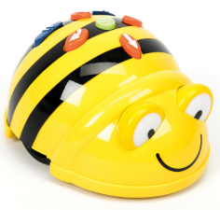
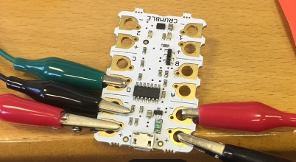
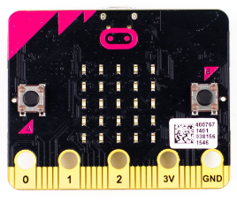
Physical computing – Year 5 and Year 6
Year 1 and 2 - BeeBots
Year 5 – Crumbles
Year 6 – Micro-bits
Don’t need to just be focussed in these year groups. They can also be used in other year groups across school.

Slide 17
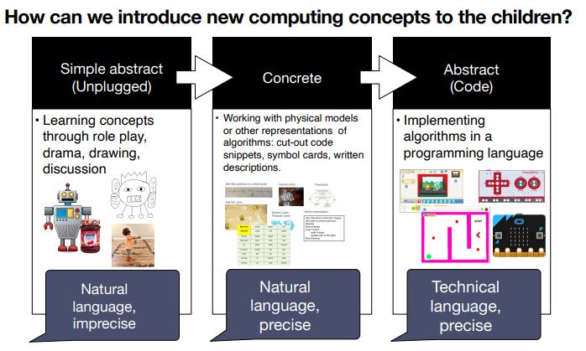

Slide 18
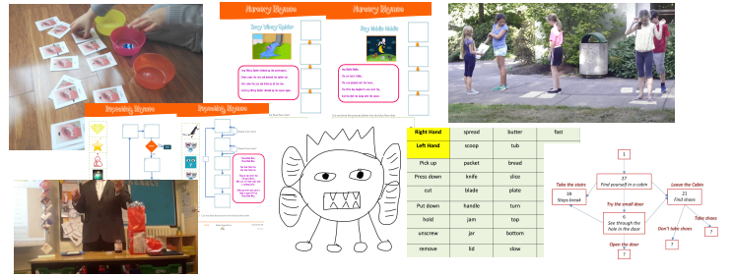
Unplugged activities

Slide 19
How Parents can help with computing at home
Expose children to safely use a range of technologies that are appropriate with an adult.
Games on sites such as Purple Mash can help develop skills
https://www.barefootcomputing.org/homelearning - Help with coding
Code Club (raspberrypi.org) – Coding activities (KS2)
Linking things you do at home to algorithms (e.g making breakfast, getting ready for school, etc)

Slide 20
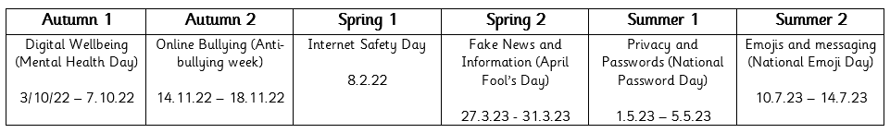
Online Safety
Key aspect of computing curriculum
Part of safeguarding our children
Exposed to weekly through online safety starters
Dedicated online safety lessons once each half term

Slide 21
The Risks
Bullying / harassment
Unwanted attention
Lack of control of images
Your ‘digital footprint’
Future career / job issues
Where the images might end up…
The legal implications

Slide 22

So what can bullying and in particular bullying online lead to?

Slide 23
Bullying can lead to:
Poor mental health
Low self esteem
No respect
No confidence
Sadness
Withdrawn
Angry
Using violence against people we love or like

Slide 24
Is everyone at Annie Lennard digitally resilient?
Know when at risk ……
Know what to do ………
Learn from experience…….
Recover from any difficulties or upsets…….

Slide 25
Our motto
At Annie Lennard
our children are at the heart of our online safety teaching.

Slide 26
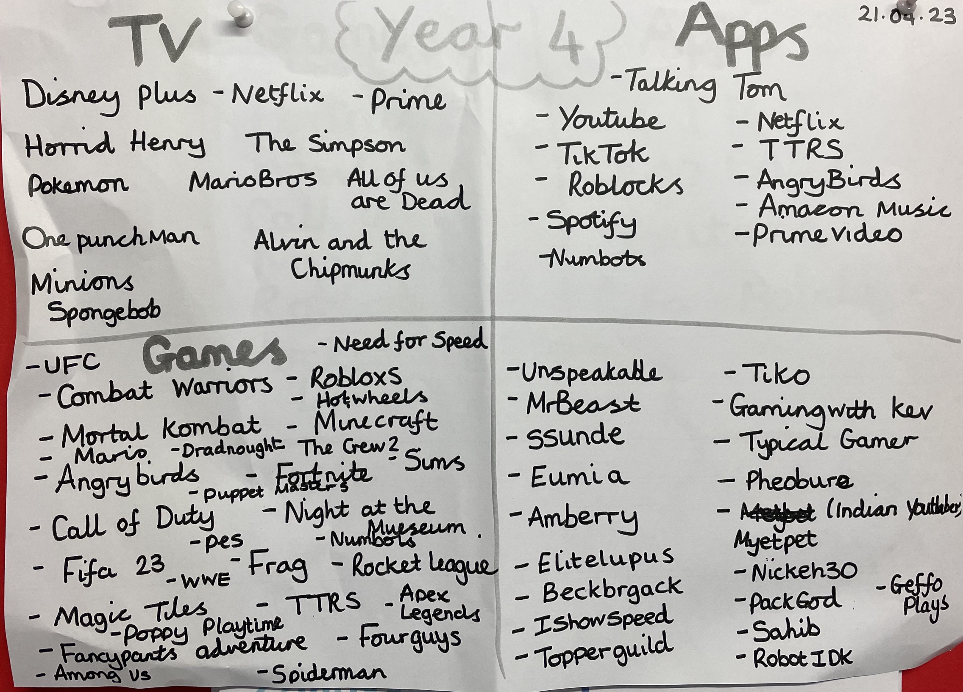
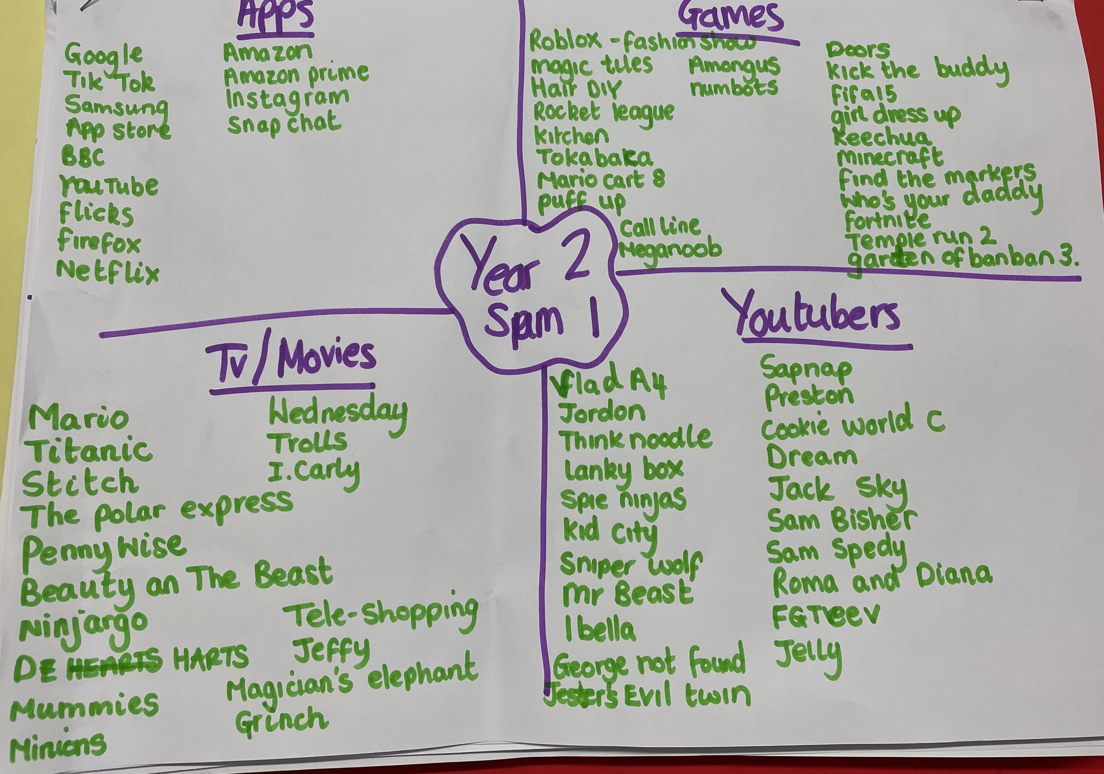
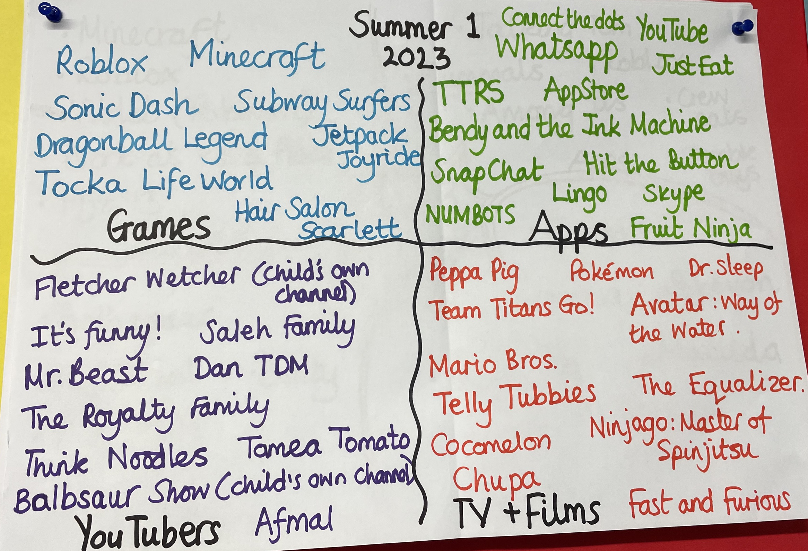
What we do in school
Online Safety Mind Maps
Working wall in the corridor
Online Safety Champions
Online Safety Starters
Regular Staff Meetings
Out reach to parents – website and through Mrs Hadden
Computing (annielennardprimary.co.uk)

Slide 27
How Parents can help with Online Safety
Parent Over Shoulder
Ensure your constantly talking to your children about what they are doing online and how they can be digitally resilient.
Research apps/programmes before allowing children to use them
NSPCC Net Aware
National Online Safety Posters
Online Safety Board
Annie Lennard School Website
Staff at school

Slide 28
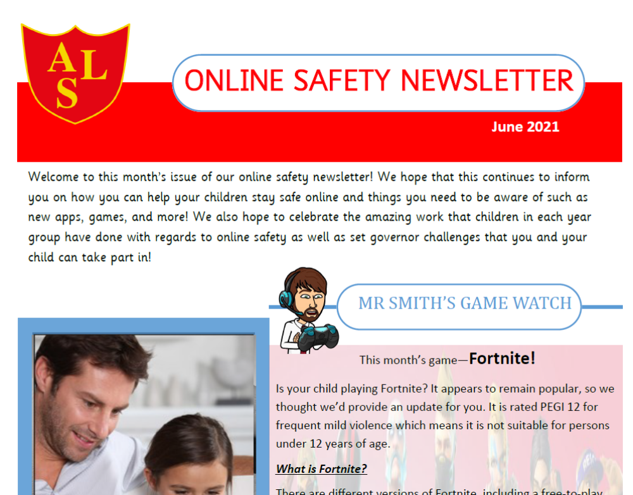
Parent Newsletter
Found on the Annie Lennard website.
One sent out at least once each half term.
Will be tailored to what our children are doing online
Hope to promote online learning in school

Slide 29






Getting help…

Slide 30
Thank you for listening
Any Questions?

